Slide 1
Project direct tier ii service learning:
Agenda for children
Lauren Reyes

Slide 2
Community-based participatory research
Research paradigm connecting research to practice
Community engagement and social action
Develop interventions for specific populations
Increase health equity
    Marginalized/underrepresented communities

Slide 3
Project overview
Task One:
    Completed “Outreach List” with details about Louisiana Congress members
        Includes office title, description, parish belonging, leadership position
Task Two:
    Researched three key issues that Agenda for Children is currently advocating for during upcoming April Legislative session
        (1) Paid leave, (2) sealing eviction records, (3) including sexual health questions on the Youth Risk Behavior Survey (YRBS)
    Drafted informational document and Power Map
Task Three:
    Added to “Outreach List” with contact information for news/media outlets in Louisiana
Notes:
- Focus: Centered around passing of state legislation and working with public policy. Primarily worked with Kenny because this is his area of expertise/the part of work he does for Agenda.
Upcoming session begins April 12th (next week)!

Slide 4
Objectives of Projects
Designates predictable political implications
    “Chairman,” “Vicechair,” and committee importance
Helps to inform political strategy for passing legislation – individuals and organizations
    Decide key players and opponents in debate
Informational document to be shared with Agenda for Children partners and similar organizations
Power Map offered exposure to:
    Studying politician voting records and communicating with legislators/organizations
Obtain contact information from smaller, more rural cities in Louisiana to expand outreach
Notes:
Champion – person with expertise in institution/governing body and also can spearhead advocacy campaign within Congress

Slide 5

First issue: paid Leave
  Issue: Employers, both public and private, should be required to pay employees with leave benefits.
        Sick leave, caring for new child, caring for ill family member, etc.
  Importance:
    Ensures parents can pay for and support children
        Financial and relationship benefits
    Maintains female participation in work force
    Boosts economy
        Decreased use of public assistance programs
    Allows families to preserve familial and professional priorities
Notes:
Paid Leave: decrease infant mortality rates and stress upon parents during times of financial hardship; strengthens caregiver-child relationships. Boosts economy: increase wage stability, decreased use of public assistance programs. Statistic: 82% of Louisianians support paid time off for all working people with specific conditions – politicians not voting with what constituents want
1/3 of Louisiana residents have taken unpaid family leave = financial hardship

Slide 6

Second Issue: sealing eviction records
  Issue: Private entities should be restricted from accessing eviction records and require landlords to acknowledge eviction proceedings/outcome.
  Importance:
    Prevents denial of application based on improper information
    Forces landlords to acknowledge eviction filing context
    Averts certain populations from “slum lords”
    Reduces burden of eviction filings
        Hardships, adverse health, discrimination

Slide 7

Third issue: sexual risk questions - YRBS
  Issue: Louisiana youth should be allowed to answer questions about sexual health/sex-related risk factors on the Youth Risk Behavior Survey (YRBS)
  Importance:
    Provide accurate data to inform interventions and policies
        Teen pregnancy, infant mortality, STIs, HIV
    Assess efficacy of existing sexual education programs
        Louisiana - abstinence only
    Monitor trends: state and nationwide
    Receive federal funding for STD/HIV prevention programs

Slide 8
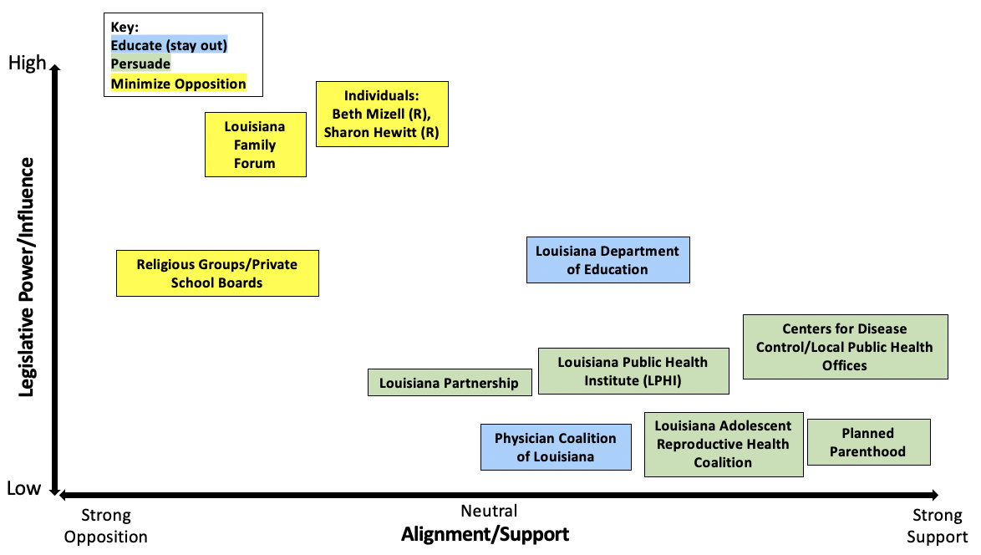
power map: Sexual health on yrbs
Pass through: Health and Wellness Committee – House Committee
Notes:
A PowerMap is a data visualization tool that helps to display data. Here, we have 2 axes: legislative power and influence and alignment/support.
Explain some: Planned Parenthood. Those that work with this organization would most definitely be in support (strong support side), but because of the controversy that is associated with this organization, I placed it towards the bottom in that they have low support. I would even stray away from including them in the debate at all because this will steer conservative Republicans automatically away, but their efforts and outreach can be helpful in disseminating information.
Louisiana Family Forum: This is a conservative non-profit advocacy group whose mission is to represent timeless biblical principles in the centers of influence on issues that directly affect families. Because of groups like this, we would not want to include Planned Parenthood in this conversation. They do hold much political power because many conservative legislators are associated/support the efforts of this organization.
Strategy: Would be to minimize opposition and get those lying in the middle of this issue to be swayed to Agenda’s side. Maybe appeal to parents/grandparents whose children may be directly affected by alcohol, drugs, violence, and also sexual health. Also, can use facts and figures that in states that do allow for this to occur, there has not been an increase in sexual activity due to the YRBS. Also, it’s anonymous and children’s information is not recorded.
Explain what Power Map is by referencing what axes and colors mean.
Pass through because

Slide 9
Race, gender, & Class intersections
Relation to CBPR (Collins et al., 2018)
How do the three key issues affect certain communities?
    Black community and various other minority groups
    Women
    Single-mothers
    Impoverished communities

Slide 10

Media outreach task
Find contact information for media/news outlets in Louisiana
    Focus: Smaller, more rural areas
        Disseminate information elsewhere
Moderates sway to Agenda’s side → greater push for legislation
Variety of media importance
Notes:
Stay away from larger cities because too many of these. Also, outreach occurs more often here, so more outreach should occur elsewhere to that more people are aware of Agenda’s efforts

Slide 11
relevant cbpr principles
Participants and community members involved in each step of process
Those that influence and/or affect policy are the final level that CBPR reaches (Cargo & Mercer, 2008)
    Affects sustainability of interventions through funding
Most ethical approach includes community allies and nonacademic partners (Cargo & Mercer, 2008)
    Offers valuable insight for legislators; incorporates community thoughts
Responsibility distributed amongst participants, researchers, community allies, and legislators (Collins et al., 2018)
Values or “drivers” are extremely important (Berge, Mendenhall & Doherty, 2009)
    Use of champion; community influence

Slide 12
Relation to project direct
Children should get “healthiest start possible”
    Development
    Support
Committed to social justice and health equity
Collaborative/partnership-based
Recognizes context and culture
Notes:
Support from various angles!

Slide 13
Knowledge gained through this experience
Small triumphs are still steps in the right direction!
    Sometimes, outcome is not always passed legislation
Better understand process of how legislation is passed through Congress
    Proposal → Bill
    Importance of strategy – one of most pivotal aspects
        Specific wording of bill
        Committee the bill is passing through
        Allies and opponents
Media/news outreach is a powerful means to connect with people

Slide 14
reflection
Personal component: my hometown is Lake Charles, LA
    Media outreach task – familiarity
    Satisfaction in that I was giving back to my state
Agenda meaningfully impacts communities
Young people can be proactive and beneficial to the solution!
    Tasks serve as foundation that can be furthered by those with expertise
    All tasks are important, no matter how small
Notes:
Familiarity. Just understanding how it all works, Kenny is so knowledable about it all

Slide 15
References
Berge, J. M., Mendenhall, T. J., & Doherty, W. J. (2009). Using Community‐Based Participatory Research (CBPR) to target health disparities in families. Family relations, 58(4), 475-488.
Cargo, M., & Mercer, S. L. (2008). The value and challenges of participatory research: Strengthening its practice. Annual Review of Public Health, 29, 325-350. doi: 10.1146/annurev.publhealth.29.091307.083824.
Collins, S. E., Clifasefi, S. L., Stanton, J., The Leap Advisory Board, Straits, K., Gil-Kashiwabara, E., Rodriguez Espinosa, P., Nicasio, A. V., Andrasik, M. P., Hawes, S. M., Miller, K. A., Nelson, L. A., Orfaly, V. E., Duran, B. M., & Wallerstein, N. (2018). Community-based participatory research (CBPR): Towards equitable involvement of community in psychology research. The American psychologist, 73(7), 884–898. https://doi.org/10.1037/amp0000167
Project direct core values. (n.d.). Retrieved April 28, 2021, from https://www.courtneynbaker.com/project-direct-core-values.html
Wallerstein, N., & Duran, B. (2010). Community-based participatory research contributions to intervention research: the intersection of science and practice to improve health equity. American journal of public health, 100 Suppl 1(Suppl 1), S40–S46. https://doi.org/10.2105/AJPH.2009.184036

