Slide 1
Tier 2 Service Learning Presentation
Elizabeth Diamond & Sydney Fama

Slide 2
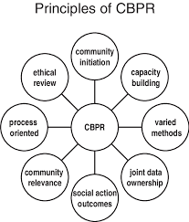
What is CBPR?
CBPR is a collaborative research design that encourages a relationship between community members, researchers, and other stakeholders
Goals:
  Bridge gap between community members and scientific community
  Improve well-being of the community by promoting positive and sustainable change
Notes:
CBPR definition
Goals of CBPR: bridge gap, improve well-being through equitable measures and promotion of positive and sustainable change
Key components revolve around these communities that are home to diverse individuals whose identities are shaped by strength, challenges, and disparities within their communities

Slide 3

Agenda for Children
Agenda for Children is an organization that works to make Louisiana, a state known for its lack of opportunity for young people, a place where children can flourish and be successful
Agenda for Children works with government officials to...
  Increase support for families through childcare and public education
  Increase healthcare access for children
  Improve the foster care system
  Assist in the juvenile justice system

Slide 4
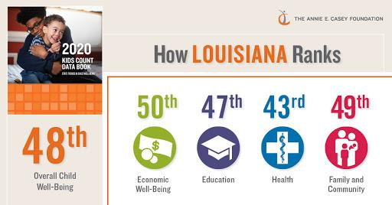
Facts about Louisiana
Louisiana ranks…
#48 in opportunity
#50 in economy
#47 in education
#41 in racial integration
3rd highest poverty rate
4th highest income inequality

Slide 5
So, what did we do?
Outreach List: Multi-Parish Elected Officials
We identified the emails of government leaders including the governor, secretary of state, attorney general, state treasurers, associate justices, members, state senators, state representatives, and district attorneys and checked off which parish(es) they represent
Goal: Allows those working for Agenda for Children to more easily access and communicate with community leaders to ultimately benefit children and families of LA
Notes:
Because populations differ from paris to parish, it is necessary to reach representatives that are most familiar with their member populations and their needs. Parish representatives are, of course, most familiar with the lifestyles and the needs of the people they represent
Through the formation of these connections between the researchers and community stakeholders, an equitable partnership can be reached

Slide 6
What next?
Outreach List: Media
We found many media outlets within Louisiana and included the contact information of reporters covering either politics, education, or healthcare
Goal: Since an important goal of CBPR is to disseminate information on a community level, media outlets help to convey information to those that reside in a specific area
Notes:
It is a necessary component of CBPR to provide community members with culturally relevant information that is specific to their needs
Additionally, we are constantly being consumed with the information presented around us. The availability of mass media has the capacity to reach a wide array of people

Slide 7
Anything else?
Outreach List: Parish Elected Officials
We identified the contact information of community leaders including: aldermen, members of the school board, mayors and presidents, police jurors, council members, and councilmen of each city and parish in Louisiana.
Goal: By contacting officials on a more local level, we felt that these leaders would be able to have the biggest impacts in their communities regarding childcare services and overall family being

Slide 8
Ultimate Benefit
We hope that our time as interns for Agenda for Children has helped to assist the organization and make their efforts easier
Our work helped to identify over 3000+ contacts, from representatives to reporters to officials, to promote rapid and effective progress
This is a daunting task for anyone and we hope our efforts can help to encourage community empowerment
We learned the value of organization as a means of increasing accessibility

Slide 9
Data Entry and CBPR
Collection of data is a vital part of any effective research project
Data analysis allows for the conclusive efforts of CBPR to be implemented into the community
Ultimately adding to the goals of Agenda for Children to improve child well-being
The dissemination of data allows for accountability and community engagement to foster a trusting and collective environment

Slide 10
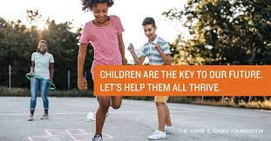
Our Takeaway from Working with Agenda for Children
Given that we are both from Long Island NY, a fairly homogeneous community, coming to Tulane made us realize that we had been privileged to have many opportunities that are unavailable to children here
Working with Agenda for Children gave us a sense of admiration for those working to improve the well-being of children and families in LA.
Notes:
Agenda provides children and their families with not only opportunity, but a voice that can be heard through awareness of social and economic diversity and in the community.
We are grateful for our time as interns for Agenda for Children as they are committed to success and want to ensure that all are given the proper tools to succeed in a world where many are considered at risk

Slide 11
Moving Forward
At first, this project made us feel disconnected from Agenda for Children’s missions and the work that our peers were doing for them
We learned the value of working on small portions of larger projects
Although data entry may seem like a mere aspect of the efforts of this organization, it is necessary to start small in order to improve overall child well-being
Notes:
It is common for people to only focus on the final product of a project. Now, we realize that each step makes a difference in the overall mission of the organization.
Agenda is focused on improvement and empowerment, thus to make improvements the small steps must be acknowledged and appreciated.

Slide 12
Works Cited
Collins, S.E., Clifasefi, S.L., Stanton, J., Straits, K.J.E., Espinosa, P.R., Andrasik, M.P., Miller, K.A., & Orfaly, V.E. (2018). Community based participatory research (CBPR): towards equitable involvement of community in psychology research. American Psychology, 73(7), 884-898.
Cargo, M. & Mercer, S.L. (2008). The value and challenges of participatory research: strengthening its practice. Annual Review of Public Health, 29, 325-350.
http://www.agendaforchildren.org

