Slide 1
The Mystery Bag
By: Sam Han

Slide 2
Introduction
Based off www.LitDiet.org (https://www.youtube.com/watch?v=NoTT0JQ-am8)
Class Goal: To develop oral language skills and basic communication
Notes:
Talk about the process and what the video showed

Slide 3
Problems
Children (Pre-k) struggled to differentiate between statements and questions.
Off-tangent when responding to questions.
Learning to respond using complete sentences.

Slide 4
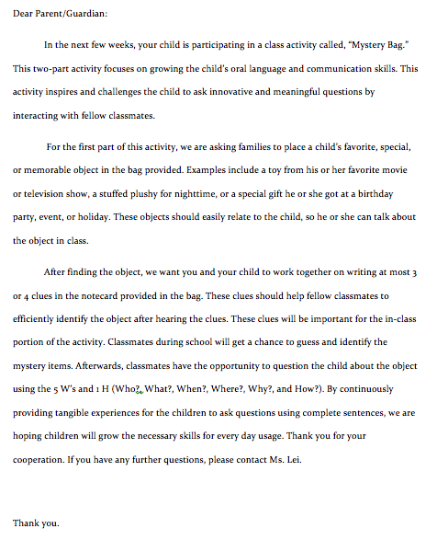
Materials
Letter of explanation for parents, notecard, and bag for the item. Item will be provided by the student.
Lesson/Introduction to the 5 W’s and 1 H

Slide 5
Results
Children are excited, active, and participating
Properly follow directions with constant reminder of the 5 W’s and 1 H.
Parent participation in activity

