Slide 1
CBPR Project:
Kindergarten Anchor Charts

Slide 2
Collaborative Effort
Communicating with teacher to identify classroom needs
  Unclear curricular objectives
Anchor charts for the classroom displaying overarching themes guiding the curriculum
      Charts with definitions and pictures that represent skills the class is learning
Mini lessons to accompany the charts

Slide 3
Goals and Aims
Help students solidify concepts by creating anchor charts
Help students think abstractly
Practice applying skills through mini lessons
Reinforce learned skills

Slide 4
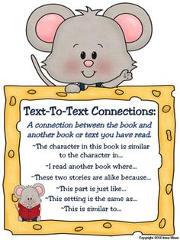
Anchor Charts
Text to Text connection chart
Accompanying lesson in which I made a Venn diagram with the students comparing different Leo Lionni books
Notes:
Little blue and little yellow
It’s mine, Fish is Fish

Slide 5
Anchor Charts
Visualize anchor chart
  Accompanying lesson in which students drew scenes from The Salamander Room
Word Family Chart
  Accompanying lessons listing rhyming words and filling out worksheets
Notes:
The Salamander Room Anne Mazer
Groups of one syllable words ending in the same sound

Slide 6
Challenges and Changes
Scheduling changes
Time constraints
The teacher often made charts and preferred I interact with the children
  To adapt to this I focused more on the lessons accompanying charts and solidifying skills and concepts

Slide 7
Outcomes
Progress hard to monitor due to time constraints
Students loved the charts and the teacher often referenced them
The accompanying lessons allowed students to practice applying concepts

