Slide 1
Research Project
Anusha Rahman
Tier-2 Service Learning

Slide 2
Community-Based Participatory Research
CBPR is a framework of research with high engagement between the researcher and the community.
Strengthens research practices by:
  Understanding the individual’s role within the community.
  Co-creating the research question and research plan.
  Co-disseminating research.
Key points:
  No superiority complex
  Cultural humility

Slide 3
Partner

Slide 4

Agenda for Children
Founded in 1984
Received grant from Annie E. Casey Foundation to be the KIDS COUNT grantee in Louisiana
  Provides accurate data on child well-being in the 64 parishes
Goal: ensure all children in Louisiana are able to thrive, by ensuring that basic needs are met.
http://www.agendaforchildren.org

Slide 5

KIDS COUNT, Annie E. Casey Foundation
Based in Baltimore
Improving well-being for at-risk youth and young adults under age 25
Holistic support
  Juvenile justice system
  Shift disinvested neighborhoods into places of economic success
  Focus on accurate data gathering and dissemination
  Raise awareness
  Help parents become financially stable
https://www.aecf.org

Slide 6
Louisiana

Slide 7
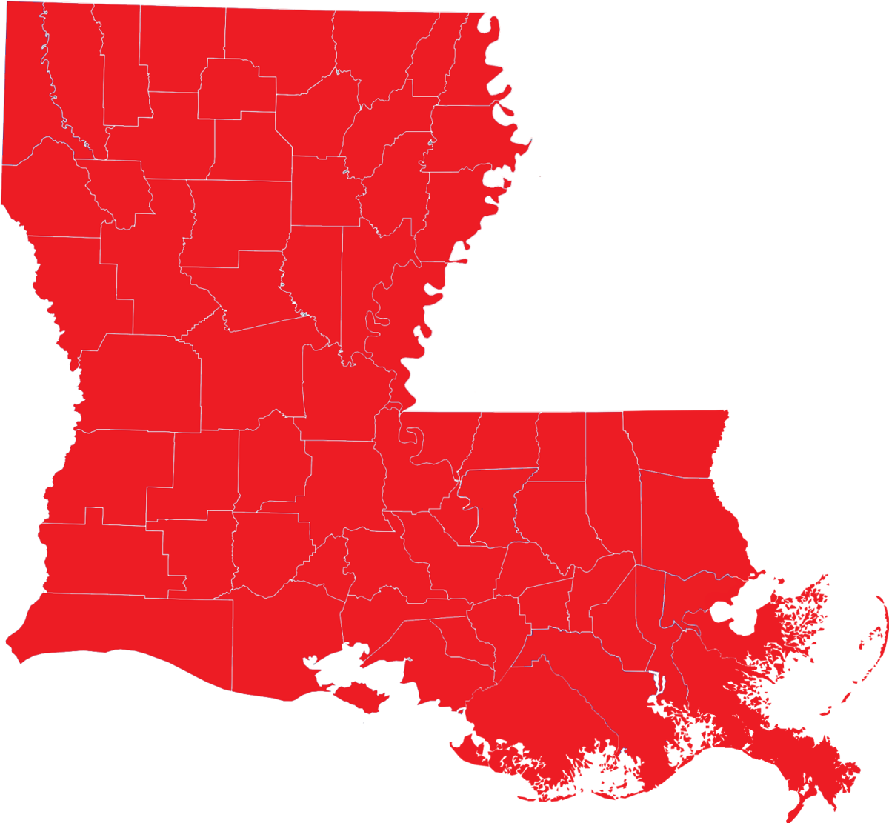
Rankings
Broad Categories
KIDS COUNT overall rank: 48th
Education: 47th
Health: 43rd
Family & Community: 49th
https://datacenter.kidscount.org/data#VA/2/0/char/0

Slide 8
Rankings
Specific Categories - Examples
Children in poverty: 26th
Children whose teeth are in excellent or good condition: 78%
Total teen births: 28 (per 1,000)
Median family income among households with children: $61, 300
Children living in households that are owned: 62%
https://datacenter.kidscount.org/data#VA/2/0/char/0

Slide 9
Projects
Project 1:
Tableau Data Visualization
Project 2:
KIDS COUNT Data Inventory

Slide 10
Project 1: Tableau

Slide 11
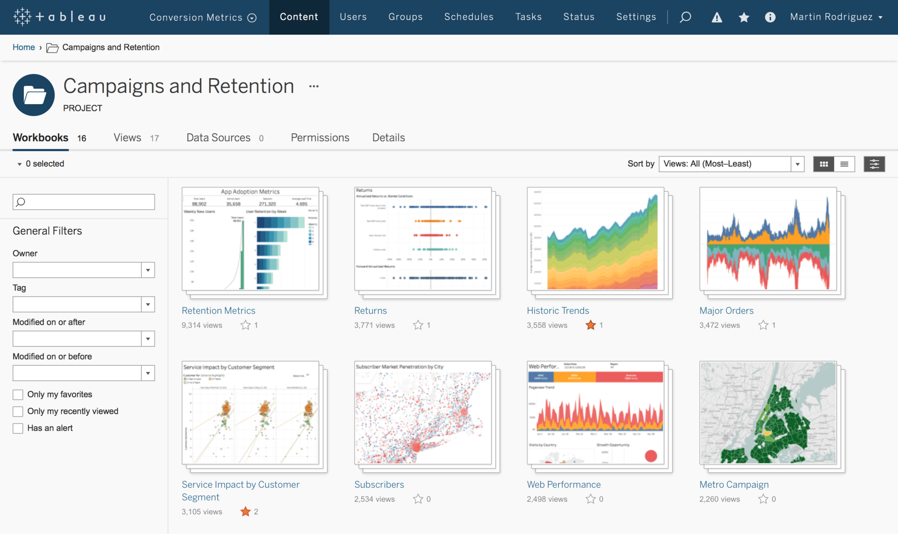
What is Tableau?
Data visualization software.
Simplifies data for the community.

Slide 12
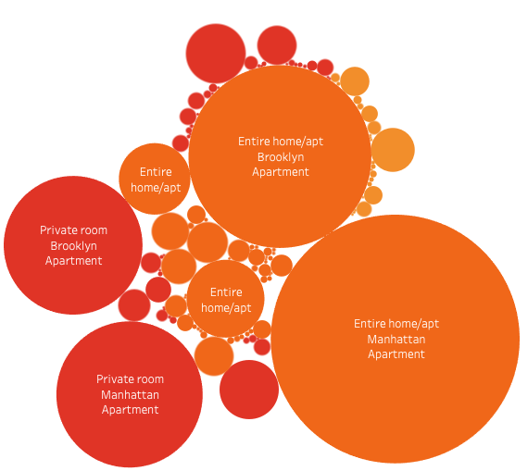
Project 1: Tableau
Simplifying information for the community
Respect
Make information eye-catching

Slide 13
Project 2: KIDS COUNT Data Inventory

Slide 14

Project 2: KIDS COUNT Data Inventory
Track 50 states’ indicators
We can’t just improve child well-being - we have to understand all factors

Slide 15
What are the indicators?
Demographic indicators
  E.g., child population by race
Economic Well-Being Indicators
  E.g., child without a vehicle at home
Education Indicators
  E.g., Head Start enrollment by age group
Family & Community Indicators
  E.g, Children living in single-parent households
Health Indicators
  E.g., Infant mortality
Safety & Risky Behaviors
  E.g., foster care entry rate
National KIDS COUNT Publications Indicators
  KIDS COUNT overall rank

Slide 16
What I’ve Learned

