Slide 1
The Rhyming Cube
Chandler C. Young

Slide 2
CBPR and this Project
Partnership approach to research that involves community members in all aspects of the research process
In this project, this was reflected from the continuous contact with the preschool teacher
  Designed learning goal in conversations with teacher

Slide 3
Inspiration and Goals
Based off of an activity proposed in Intervention Central’s RTI Toolkit: A Practical Guide for Schools
Main goal: To promote engagement in rhyming exercises through an interactive activity using die

Slide 4
Why Rhyming?
Initially, the project was designed to feature single letters on the die
The teachers, however, expressed that rhyming was a skill the children were having trouble getting invested in

Slide 5
The Cube
Homemade cube
  Cardboard
  Paint
  Stencil
Words on the cube included: ‘Cat’, ‘Boat’, ‘Dog’, ‘Top’, ‘Ball’, and ‘Son’

Slide 6
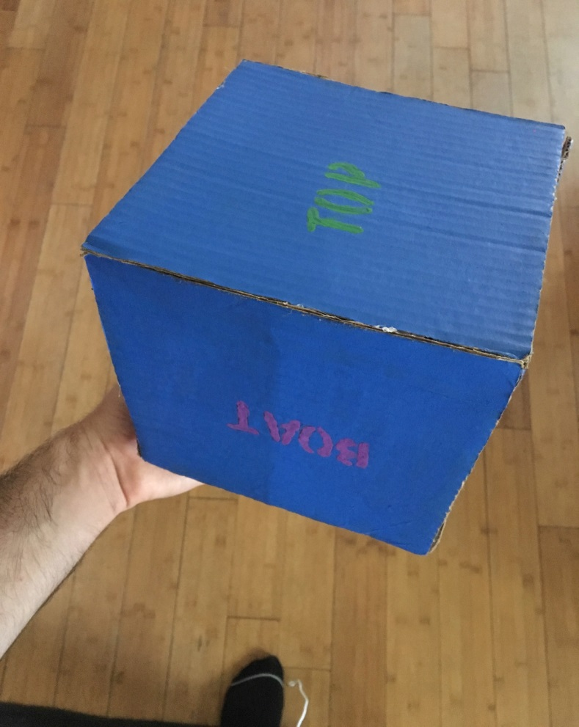

Slide 7
Results
Overall the children were very engaged with the unique learning style presented
Children that disengaged from paper-pencil activities fully participated

Slide 8
Problems
Children got too rough with the cube when first introduced
  One put their whole weight on the cube and broke it

Slide 9
Beyond Rhyming
The cube facilitated a phonics lesson as well
    The teacher and I would have the children sound out the words in addition to spelling them
Taught children the importance of sharing

Slide 10
Future Directions
This activity can be incorporated into many lesson plans
  Must be careful or it runs the risk of losing it’s novelty
Perhaps get an artistic professional to create the cube
  Use more durable material
  Use more than one cube

Slide 11
Reference
Wright J. (2012, March 14). The Classroom Teacher as Intervention ‘First Responder’: Tools for Academic Intervention and Assessment. Retrieved from http://www.fehb.org/CSE/CCSEConference2012/wright_CCSE_Pre_Conference_Tchr_First_Responder_14_Mar_2012.pdf

